Slide 1
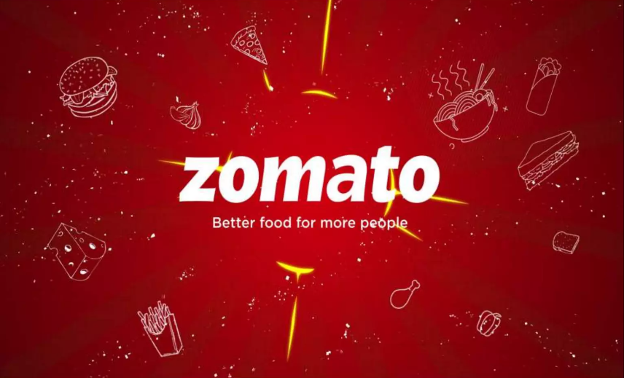

Slide 2


Zomato Business data analysis PROJECT
By Pratik Nandanwar
(DS’OCT Batch)

Slide 3
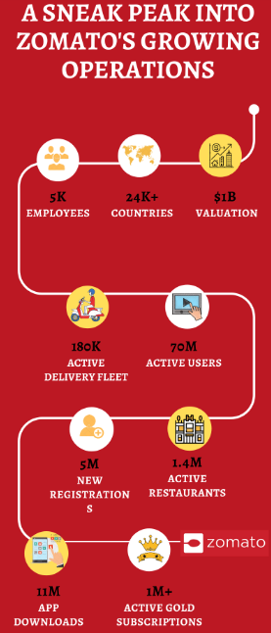

Introduction & objectives
Zomato is a food based service industry helping
people to locate , order and dine in in restaurants.
The objective of this project is to
Analyse the existing data on food industry
Draw insights from it for current trends and sentiment of food
industry.
Understand the trends and look for opportunities for
investment in market and opening new restaurants.

Slide 4
Overview of Data
Countries 15
Cities
15
Total restaurants 9551
Cuisines
250
HIGEST NUMBER OF RESTAURANTS
INDIA
LOWEST NUMBER OF RESTAURANTS
CANADA
HIGEST NUMBER OF RESTAURANTS
STARTED IN
2018
LOWEST NUMBER OF RESTAURANTS
STARTED IN
2012

Slide 5
Methodology
1-Data Cleaning
Raw source data was cleaned for accurate analysis & minimize error using excel functions like VLOOKUP,DATE & STRING FUNCTIONS.
2-Data analysis
Cleaned data was analysed in a objective & subjective manner using various aggregations functions and logics for deriving insights and suggestion based on data.
4- Further suggestions and operations
Suggestion regarding further actions and advices are made for successful establishment of business.
3-Deriving insights
Based on the analysis insights & conclusions were obtained for further business workup

Slide 6
Objective key findings
INDIA,USA,UK,UAE,SOUTH AFRICA,NZ,BRAZIL,TURKEY
Has the highest number of restaurants.
Highest number or openings – 2018
Lowest number of openings - 2012

Slide 7
Objective key findings
Major % of 46.53% lie in price range 1.
Only 6% restaurants lie in price range of 4.
INDONESIA has the highest number of voters.
Brazil has the lowest number of voters.

Slide 8
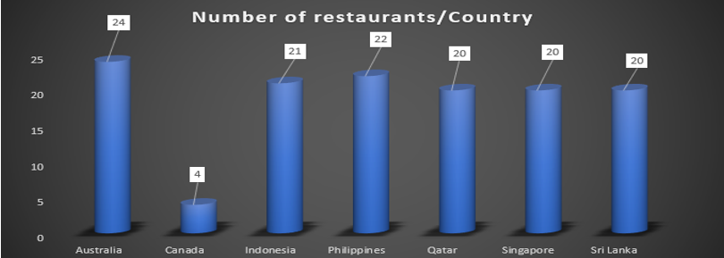
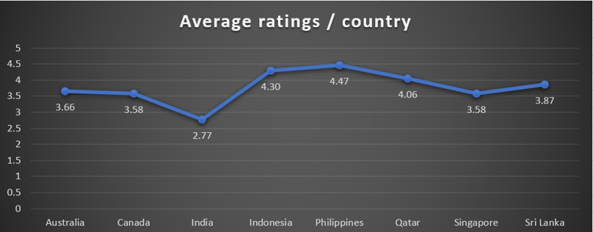
Subjective key findings
COUNTRIES & CITIES WHERE INVESTMENT CAN BE PLANNED
Considering the current numbers of restaurants , population , locations(capital , tourism etc.),Ratings following are the countries where investment can be done
CANADA – Consort & Yorkton
SRI-LANKA – Kandy , Galle, Sri Jayewardenepura Kotte, Trincomalee
AUSTRALIA – Paynesville, Montville, Mayfield
INDIA - Bangalore, Ahmedabad ,Pune , Mumbai ,tourist city like goa, Ghaziabad, New Delhi ,Noida ,Faridabad.
`

Slide 9
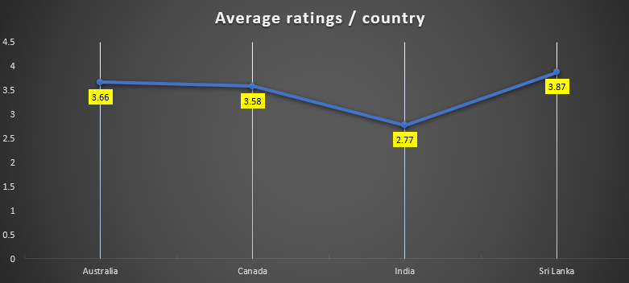
Subjective key findings
Current quality of service in suggested countries and how profitability can be achieved from it.
In the suggested countries
INDIA has the lowest quality of services currently provided.
Where as AUSTRALIA,CANADA, Sri- lanka had a below average nominal quality provided.
These countries were filtered due to its lowest average ratings which suggests that there is some gap in the market in terms of which quality should be provided and existing market here is not able to provide.
Hence if strategic planning is done and the identified gap services is provided then profitability can be achieved.

Slide 10
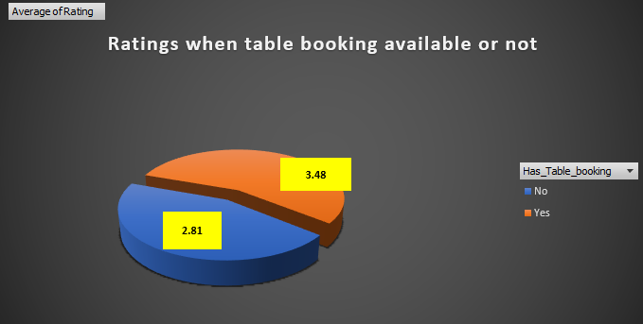
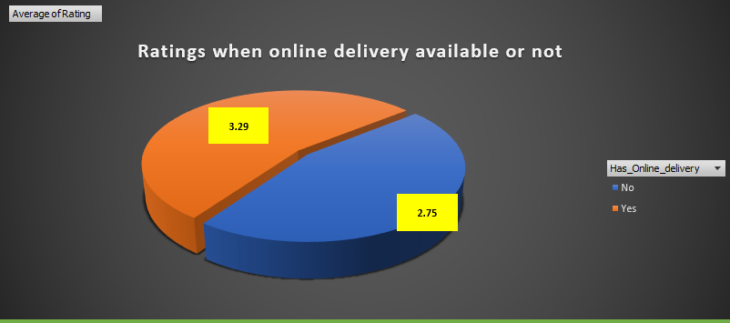
Subjective key findings
Fluctuations of ratings when services of table booking & online services provided or not.
On analysing the effects of service of table booking
and online delivery on ratings.
Following insights can be generated.
As it can be seen a general trend is where a restaurants offers table bookings had greater average ratings compared to where no table bookings were offered.
Also it can be seen when the restaurant offers online delivery the average ratings were much higher than when it doesn't offers.
It can be Concluded – Table bookings and Online delivery should be offered and has direct relationship with ratings.

Slide 11
Strategic recommendations.
The ratings are the indicator of the gap of the services which the existing restaurants are not able to provide hence identifying this gap it is must.
The services/factors identified in gap can be then provided by
Pre-planning in hotel management
Using various techniques of food production which would help in good quality in minimal cost.
This would draw the attention of population when the services would be available with the same price range this would help to capitalize upon the volume of business leading to profitability.
Logistical support and modern services like online booking and having online presence and delivery’s shall be availed compulsorily for greater ratings which would increase the popularity of restaurant and in turn be profitable.

Slide 12
Strategic recommendations.
Smart menu designing ,big kitchen production methods , preserving, techniques can be used which facilitates the optimised usage of available funds and cost cutting on needed areas in a hotel business.
Kiosk model can be thought of where the average expenditure power of population is not that high and the focus and need of the customer is just the food and taste of food instead of services. Which would save the cost of infrastructure and help in being profitable.
Choice of cuisines unless and until they are relevant to the population does not matters for the ratings of newer opened restaurants. As it was noticed that the same cuisine which had higher rating in one restaurant had lower rating in another restaurant. Hence it is better to focus on the quality, service and taste of the cuisines.
The prices ranges of cuisines are moderately corelated to the ratings of restaurants. As it was observed in the data sets ,higher price range helps achieving good ratings ,but it can also achieved by providing value to customers in a medium price ranged. So the factors should be kept in mind to keep the price range and services balanced before taking decisions to yields utmost profits.

Slide 13
CONCLUSION
Countries to invest.
AUSTRALIA,CANADA, SHRI LANKA & INDIA.
Availing modern services.
Providing services of online delivery, table bookings is must.
Services like on the take away , within time limit delivery would also help.
Using modern techniques.
Techniques like big kitchen , mass kitchen production , modern food preserving can help cost cutting.
Using modern models like kiosk model of food outlet can help achieve objective.
Based on existing counts and ratings.

Slide 14
CONCLUSION
Services to focus
Services and quality in terms of food , ambience, taste is more important compared to strategizing on cuisine type.
Model to establish.
Kiosk model , model focused on ambience , model focused on ambience with food taste and quality shall be dependent on average expenditure power of population in respective country.

